Slide 1
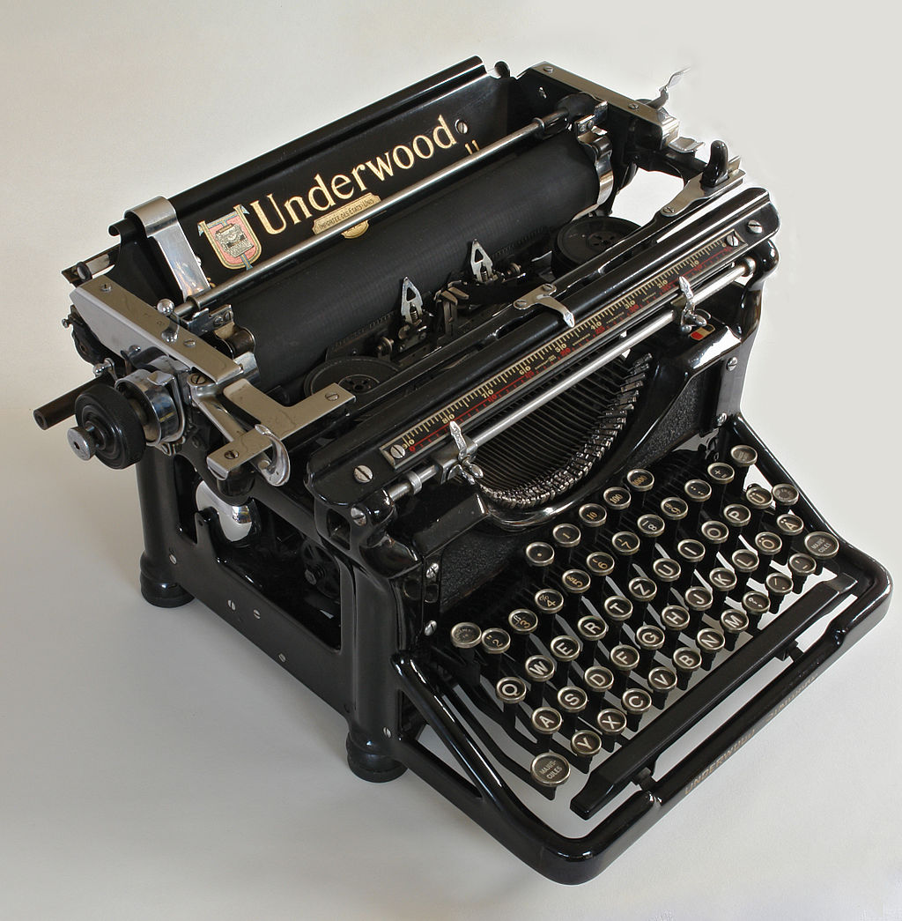
Notes:
Introducing the Underwood No.5

Slide 2
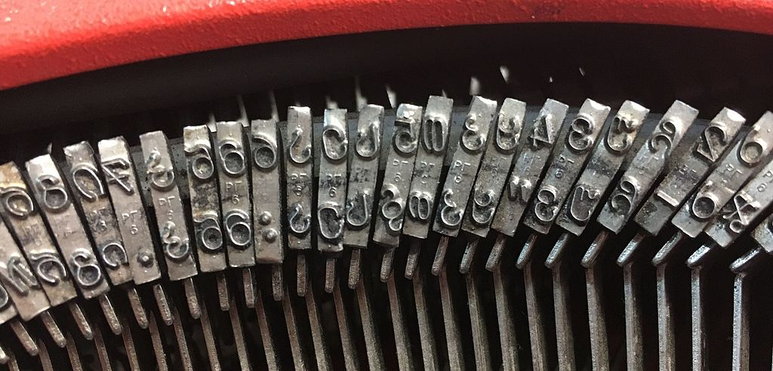
Notes:
Introducing the Underwood No.5

Slide 3
Typography
with CSS
Text Properties, Readability & Web Fonts

Slide 4
CSS Normalization & Reset
Clearing the Decks

Slide 5
CSS Normalization & Reset
Reset – override or delete all browser default styles
Eric Meyer’s “Reset CSS”: http://meyerweb.com/eric/tools/css/reset/
Normalization – make all browser default styles the same (or close to it)
Normalize.css: http://necolas.github.com/normalize.css/

Slide 6
Typeface Options
Web-Safer Fonts and Font Embedding
Notes:
http://www.smashingmagazine.com/2010/11/04/best-practices-of-combining-typefaces/

Slide 7
Web Safe(r) Fonts
Sans-Serif | Serif | Monospaced | Fantasy | Script
Arial Arial Black Arial Narrow Arial Rounded MT Bold Avant Garde Calibri Candara Century Gothic Franklin Gothic Medium Futura Geneva Gill Sans Helvetica Impact Lucida Grande Optima Segoe UI Tahoma Trebuchet MS Verdana | Baskerville Big Caslon Bodoni MT Book Antiqua Calisto MT Cambria Didot Garamond Georgia Goudy Old Style Hoefler Text Lucida Bright Palatino Perpetua Rockwell Rockwell Extra Bold Times New Roman | Andale Mono Consolas Courier New Lucida Console Lucida Sans Typewriter Monaco | Copperplate Papyrus | Brush Script MT
Notes:
http://cssfontstack.com/

Slide 8
Font Embedding with @font-face
@font-face {
[font-family: <family-name>;]?
[src: [ <uri> [format(<string>#)]? | <font-face-name> ]#;]?
[unicode-range: <urange>#;]?
[font-variant: <font-variant>;]?
[font-feature-settings: normal|<feature-tag-value>#;]?
[font-stretch: <font-stretch>;]?
[font-weight: <weight>];
[font-style: <style>];
}
Notes:
https://developer.mozilla.org/en-US/docs/CSS/@font-face

Slide 9
Visual Hierarchy
Communicating Relative Importance
Notes:
http://coding.smashingmagazine.com/2009/04/03/8-simple-ways-to-improve-typography-in-your-designs/

Slide 10
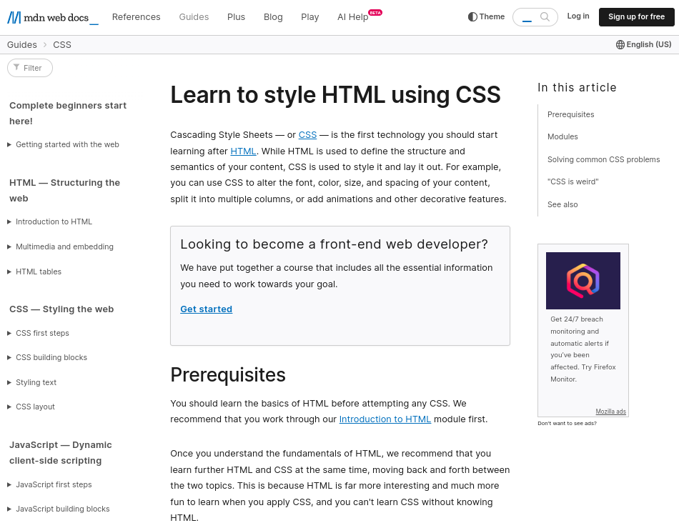

Slide 11
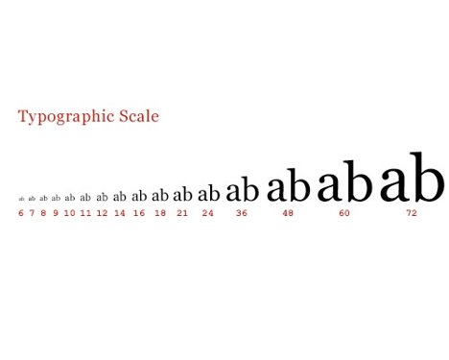
Consider a Typographic Scale
h1 {
font-size: 48px;
}
h2 {
font-size: 36px;
}
h3 {
font-size: 24px;
}
h4 {
font-size: 21px;
}
h5 {
font-size: 18px;
}
h6 {
font-size: 16px;
}
p {
font-size: 14px;
}
Notes:
http://coding.smashingmagazine.com/2009/04/03/8-simple-ways-to-improve-typography-in-your-designs/

Slide 12
Contrast
Notes:
Textures, Gradients, & Shadows should also be discussed here.

Slide 13
An example of insufficient contrast resulting in poor readability
An example of sufficient contrast resulting in good readability

Slide 14
Leading
Spacing Between Lines
Notes:
http://coding.smashingmagazine.com/2009/04/03/8-simple-ways-to-improve-typography-in-your-designs/

Slide 15
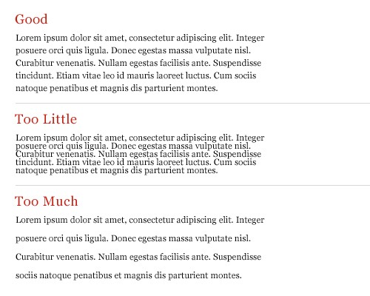
Notes:
The idea here is to produce a good typographic ‘color’ - the longer the measure, the greater the leading required.

Slide 16
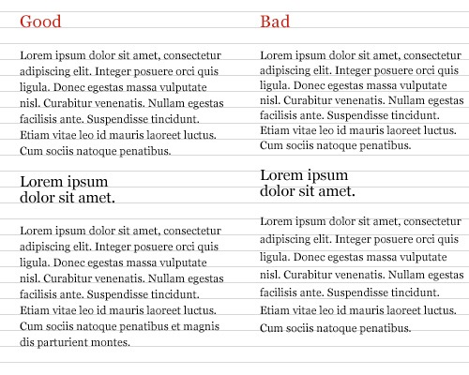
Notes:
Maintain vertical rhythm - keep aligned to a baseline grid

Slide 17
line-height: 1.5;

Slide 18
Tracking
Spacing Between Characters
Notes:
Why and when to adjust tracking and how it is different from kerning
try...
http://www.markboulton.co.uk/journal/five-simple-steps-to-better-typography-part-4
h1, h2, h3, p.intro {
text-rendering: optimizeLegibility;
}
/* enables native font kerning table values */

Slide 19
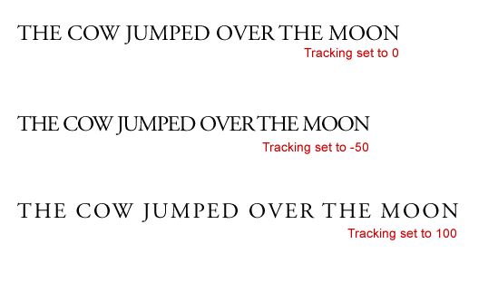
Notes:
Image from the great article by Jennifer Farley at SitePoint:
http://www.sitepoint.com/spaced-out-tracking-in-typography/

Slide 20
letter-spacing: 0.2em;

Slide 21
Measure
Controlling Line Length

Slide 22
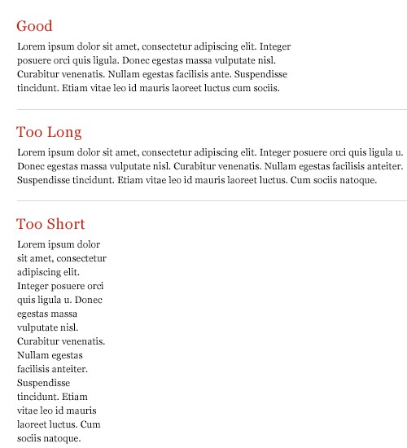
Notes:
http://coding.smashingmagazine.com/2009/04/03/8-simple-ways-to-improve-typography-in-your-designs/
For single-column design, 65 characters is considered ideal

Slide 23
width: 80vw;

Slide 24
Whitespace
Margins, Gutters, & Indentation
Notes:
Perhaps CSS columns here and avoiding indenting the first paragraph of an article with p + p { text-indent: 2em; }?

Slide 25
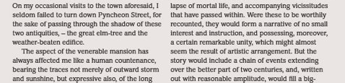
https://www.fonts.com/content/learning/fontology/level-2/text-typography/columns

Slide 26
Justification
How Line Breaks Are Handled
Notes:
Discuss clean rags and hyphenization with CSS here.

Slide 27
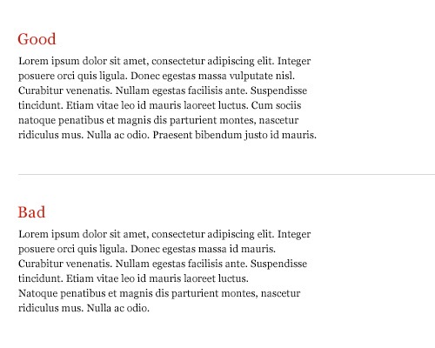
Notes:
http://coding.smashingmagazine.com/2009/04/03/8-simple-ways-to-improve-typography-in-your-designs/

Slide 28
References
File:Underwood-overview.jpg https://commons.wikimedia.org/wiki/File:Underwood-overview.jpg self [GFDL (http://www.gnu.org/copyleft/fdl.html), CC-BY-SA-3.0 (http://creativecommons.org/licenses/by-sa/3.0/) or CC BY-SA 2.5 (https://creativecommons.org/licenses/by-sa/2.5)], from Wikimedia Commons
File:Typewriter Georgian Letters.jpg https://commons.wikimedia.org/wiki/File:Typewriter_Georgian_Letters.jpg Akaki Razmadze [CC BY-SA 4.0 (https://creativecommons.org/licenses/by-sa/4.0)], via Wikimedia Commons
Tracking, Leading, Typographic Scale. Image from the great article by Jennifer Farley at SitePoint: http://www.sitepoint.com/spaced-out-tracking-in-typography/
Measure, Typographic Scale, Justification http://coding.smashingmagazine.com/2009/04/03/8-simple-ways-to-improve-typography-in-your-designs/
Web Safer Fonts: http://cssfontstack.com/
Font Embedding with @Font-Face: https://developer.mozilla.org/en-US/docs/CSS/@font-face
"Learn to Style HTML using CSS" (screenshot). https://developer.mozilla.org/en-US/docs/Learn/CSS

Slide 29
Let’s give it a try…

